Slide 1


Daily CSI
Spot the Differences
Scary Movie
8th Grade Forensic Science
T. Trimpe 2008 http://sciencespot.net/

Slide 2
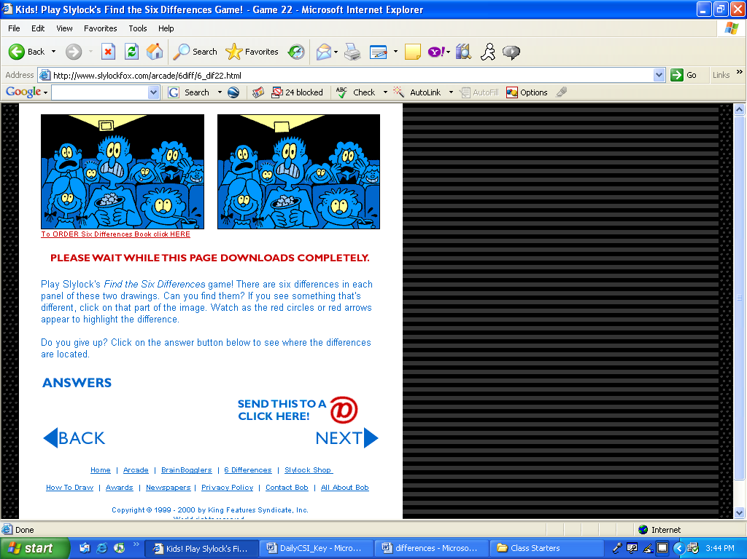
Find the 6 differences between the two pictures.
Source: http://www.slylockfox.com/arcade/6diff/index.html

Slide 3
The answers are …
Answers: Man’s shirt, movie projector, missing popcorn,
missing girl’s tooth, woman’s hair, missing chair back
Source: http://www.slylockfox.com/arcade/6diff/index.html

